Slide 1
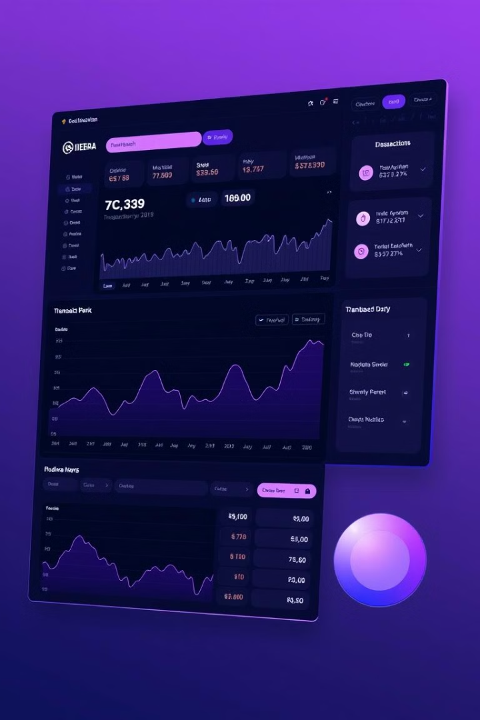
Real-Time Transaction Tracker
This Presentation Details Building A Real-time Transaction Tracker Using Hedera's Mirror Node API. We Focus On Frontend Development And API Integration To Provide Users With Immediate Insights Into Hedera Network Transactions.
TEAM MAMEBER:-
D23CE165 NIPAM ROHIT
D23CE181 DHRUV PRAJAPATI
D23CE182 MAHAMADHUSEN KURESHI
D23CE184 HENIM PANDIYA

Slide 2

Understanding the Hedera Mirror Node API
1
API Overview
2
Key Endpoints
3
API Documentation
The Hedera Mirror Node API Provides Access To Real-time And Historical Data From The Hedera Network, Offering A Comprehensive View Of Network Activity. It Is A Valuable Resource For Applications Requiring Detailed Insights Into Transactions, Account Balances, And Network Events.
The Primary Endpoints For Accessing Transaction Data Are /Transactions And /Accounts/{Account.Id}/Transactions. The Former Allows Retrieval Of All Transactions On The Network, While The Latter Filters Transactions For A Specific Account. These Endpoints Are Critical For Building The Transaction Tracker.
The API Documentation Provides Comprehensive Details On Each Endpoint, Including Request Parameters And Response Formats. For Example, A GET Request To /Api/V1/Transactions?Order=desc&limit=10 Fetches The 10 Most Recent Transactions, Returning Details Such As Transaction ID, Timestamp, Result, And Fee, All In JSON Format.

Slide 3
Core Components: Data Fetching
Framework Selection
1
Choose a JavaScript framework like React, Vue, or Angular.
2
HTTP Requests
Use the `fetch` API or libraries like `axios` to simplify HTTP requests and handle authentication.
Real-Time Updates
3
Explore WebSockets for persistent connections and continuous transaction updates.

Slide 4




Designing the User Interface
Display Recent Transactions
Filter Transactions
Enable Quick Searches
Show Detailed Transaction Data
Filter by account ID, type, or status for focused analysis.
Transaction ID, Timestamp, Account ID, Fee, and Status in a table.
Allow searches for transactions using transaction ID or other details.
Display account info and metadata in a details panel.
Utilize libraries like Material UI, Bootstrap, or Ant Design for pre-built components and a consistent interface.

Slide 5
Displaying Transaction Data
1
Readable Timestamps
2
Clear Account IDs
Format timestamps for better readability using methods like toLocaleTimeString().
Present account IDs clearly, ensuring separation between parts.
3
Status Indicators
4
Transaction ID Links
Use color-coding for status indicators: green for success and red for failure.
Optionally, link transaction IDs to a block explorer for detailed information.
For large datasets, implement pagination or infinite scrolling to enhance performance.

Slide 6
Deployment and Hosting
Frontend Deployment
1
Deploy to Netlify, Vercel, or GitHub Pages.
2
CI/CD Setup
Automate updates via GitHub integration.
Professional Hosting
3
Secure a professional domain and SSL certificate.
Deploy a React app to Netlify using a GitHub repository for automatic updates.

Slide 7

Fetching Data
Retrieve real-time transaction data from the Hedera Mirror Node API.
API Calls
Data Structure
Use HTTP requests to fetch transaction data.
Understand the JSON format of the API response.

Slide 8

Conclusion
We've explored the key aspects of building a real-time transaction tracker using the Hedera Mirror Node API.

Slide 9

References
For more information on the Hedera Mirror Node API, refer to the official documentation:
https://docs.hedera.com/guides/mirror-node-api

Slide 10




